Slide 1

Analysing the relationship between economic measures and International Trade
Aakansha Kandel

Slide 2
Research Question
Measures:
“GDP represents the total value of final goods and services produced within a country during a given period.” (World Bank)
GDP per capita reflects the average economic output per person
Study compares which indicator is more closely linked to trade levels
“Which economic indicator—GDP or GDP per capita—is more strongly associated with international trade levels?”

Slide 3

Purpose
The purpose of this study is to determine whether GDP or GDP per capita is more closely related to international trade activity.
International trade is essential for
Economic growth (World Bank, World Trade Organisation)
Global integration
Poverty reduction(World Bank statement)
Most research focuses on the impact of trade on GDP
This study examines which economic factor drives trade levels
Compares GDP vs GDP per capita to understand strongest association

Slide 4
How this analysis helps?
Doing analysis on relationship of economic factor and trades helps economists:
Understand the relationship between economic size and international trade.
Explains why some countries trade more than others
Support further research into factors that influence trade participation
Help economists develop and improve models that explain and predict global trade patterns
Provide evidence that economic size may play a stronger role in trade than income per person.

Slide 5
Hypothesis
Countries with larger economies (higher GDP) will have higher total trade volumes

Slide 6

Data Selection
Data sourced from United Nations Data Portal
10 year dataset(2015-2024)
Six countries selected
  High income: Australia, USA
  Upper-middle income: China, Brazil
  Developing: India, Vietnam
data.un.org/Explorer.aspx

Slide 7
Data Preparation
Data processing steps using PySpark:
Loaded and cleaned raw data
Standardised names, removed invalid values
Aggregated exports, imports, total trade, trade balance
Merged datasets into the final analysis

Slide 8
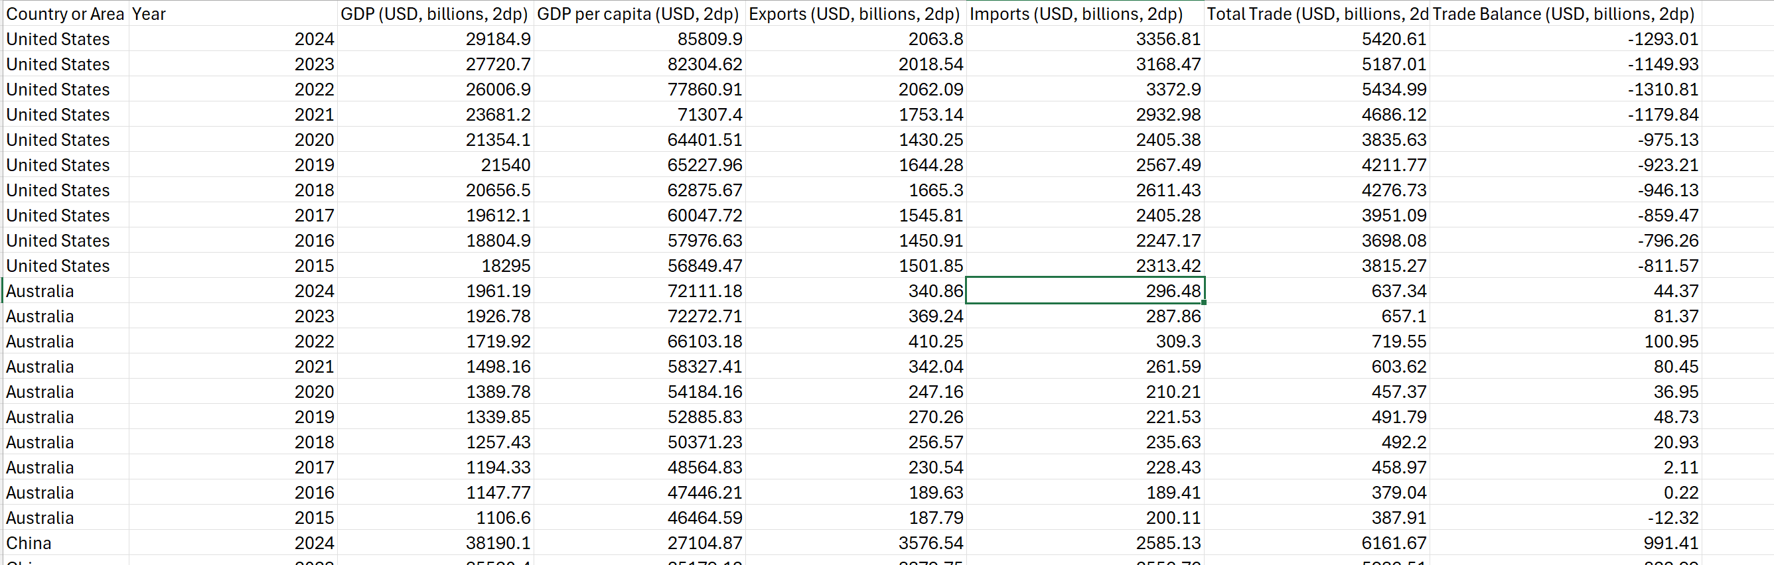

Slide 9
Data Visualisation
The cleaned dataset was analysed and visualised
The workflow:
Processing data in PySpark
Converted and cleaned the dataset to Pandas for visualisation
Created graphs using Matplotlib
NumPy used to calculate regression lines, for the line of best fit

Slide 10
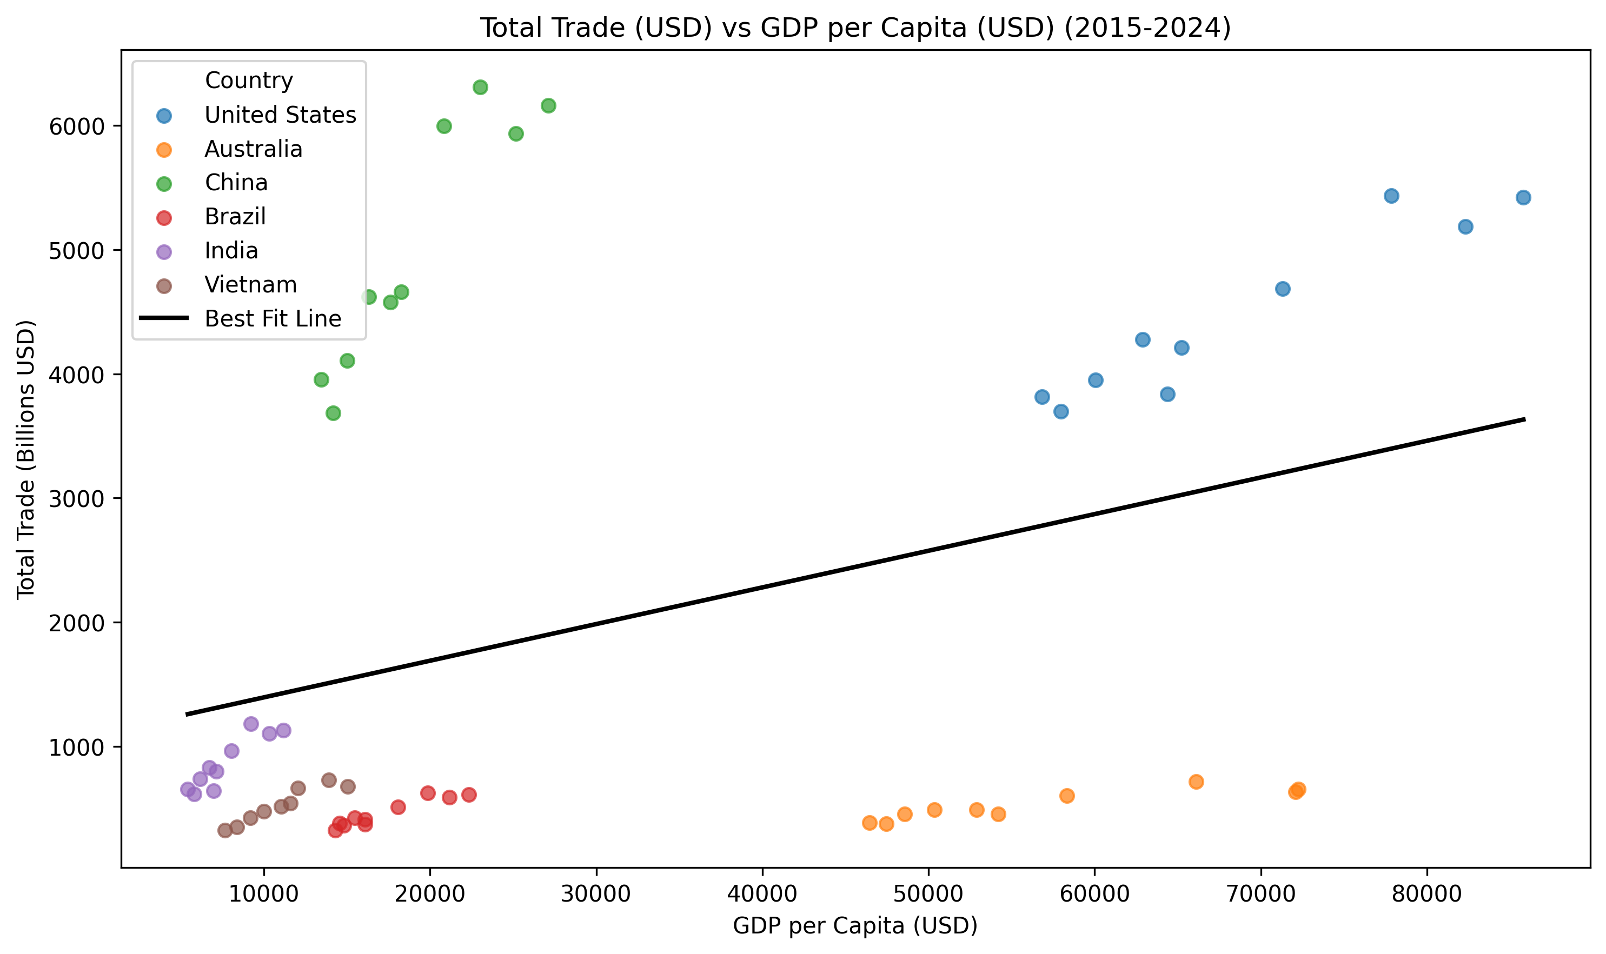

Slide 11
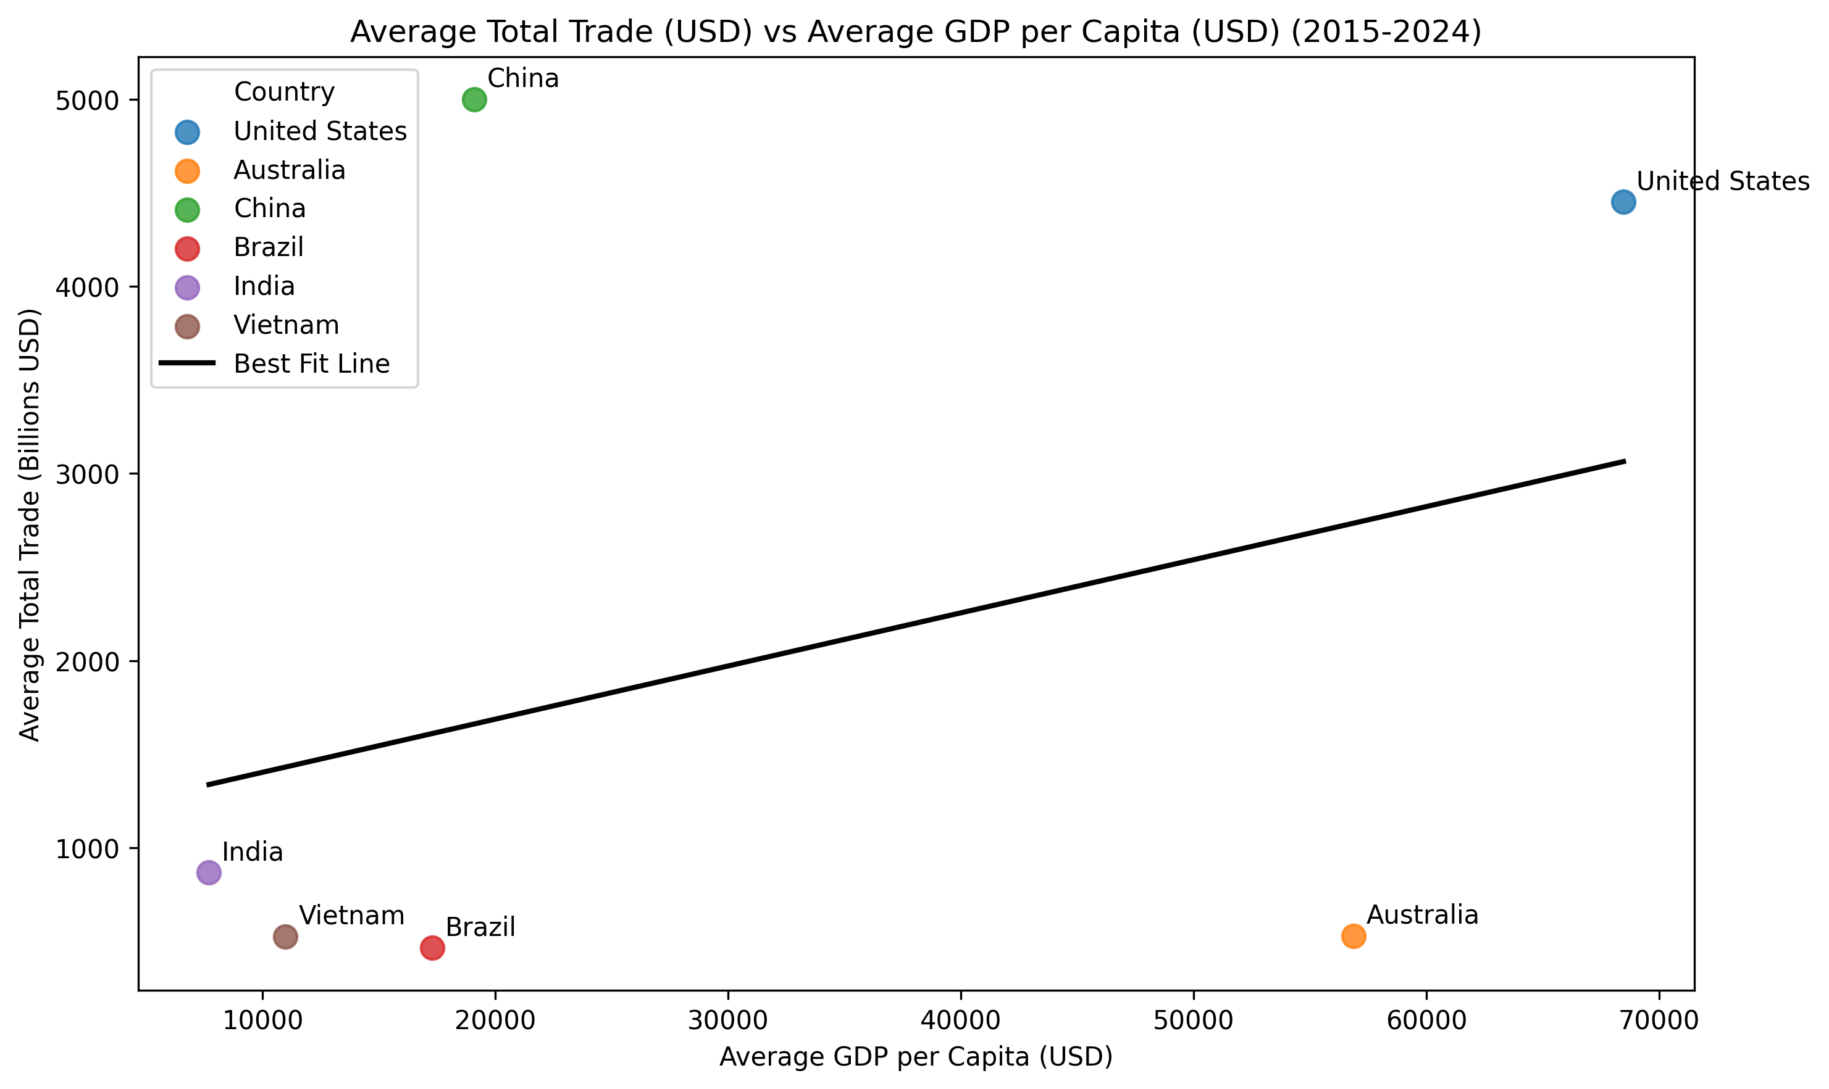

Slide 12
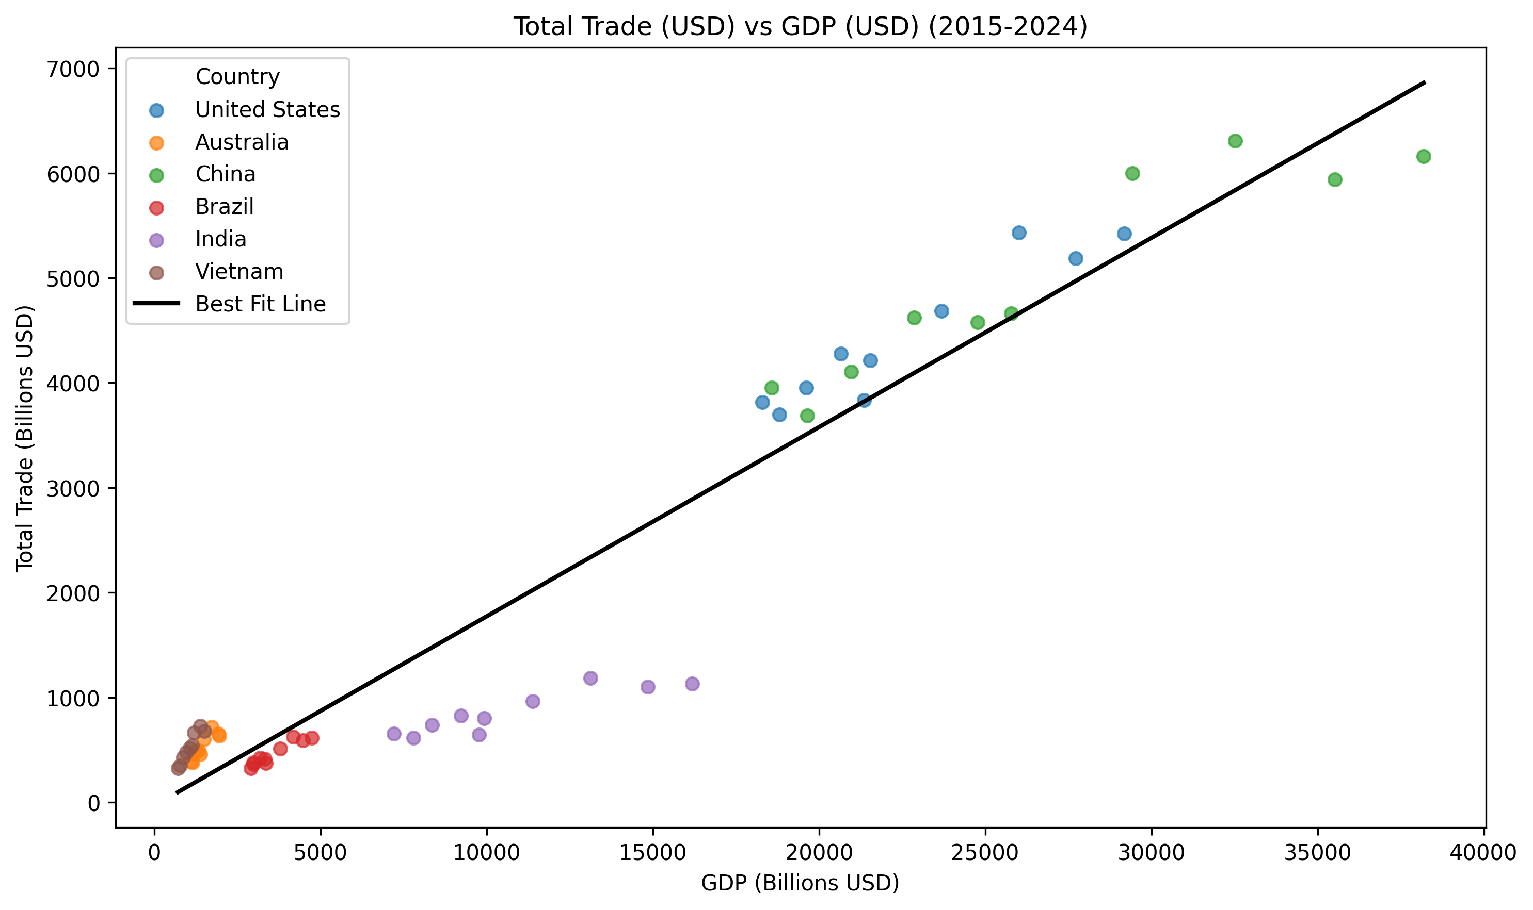

Slide 13
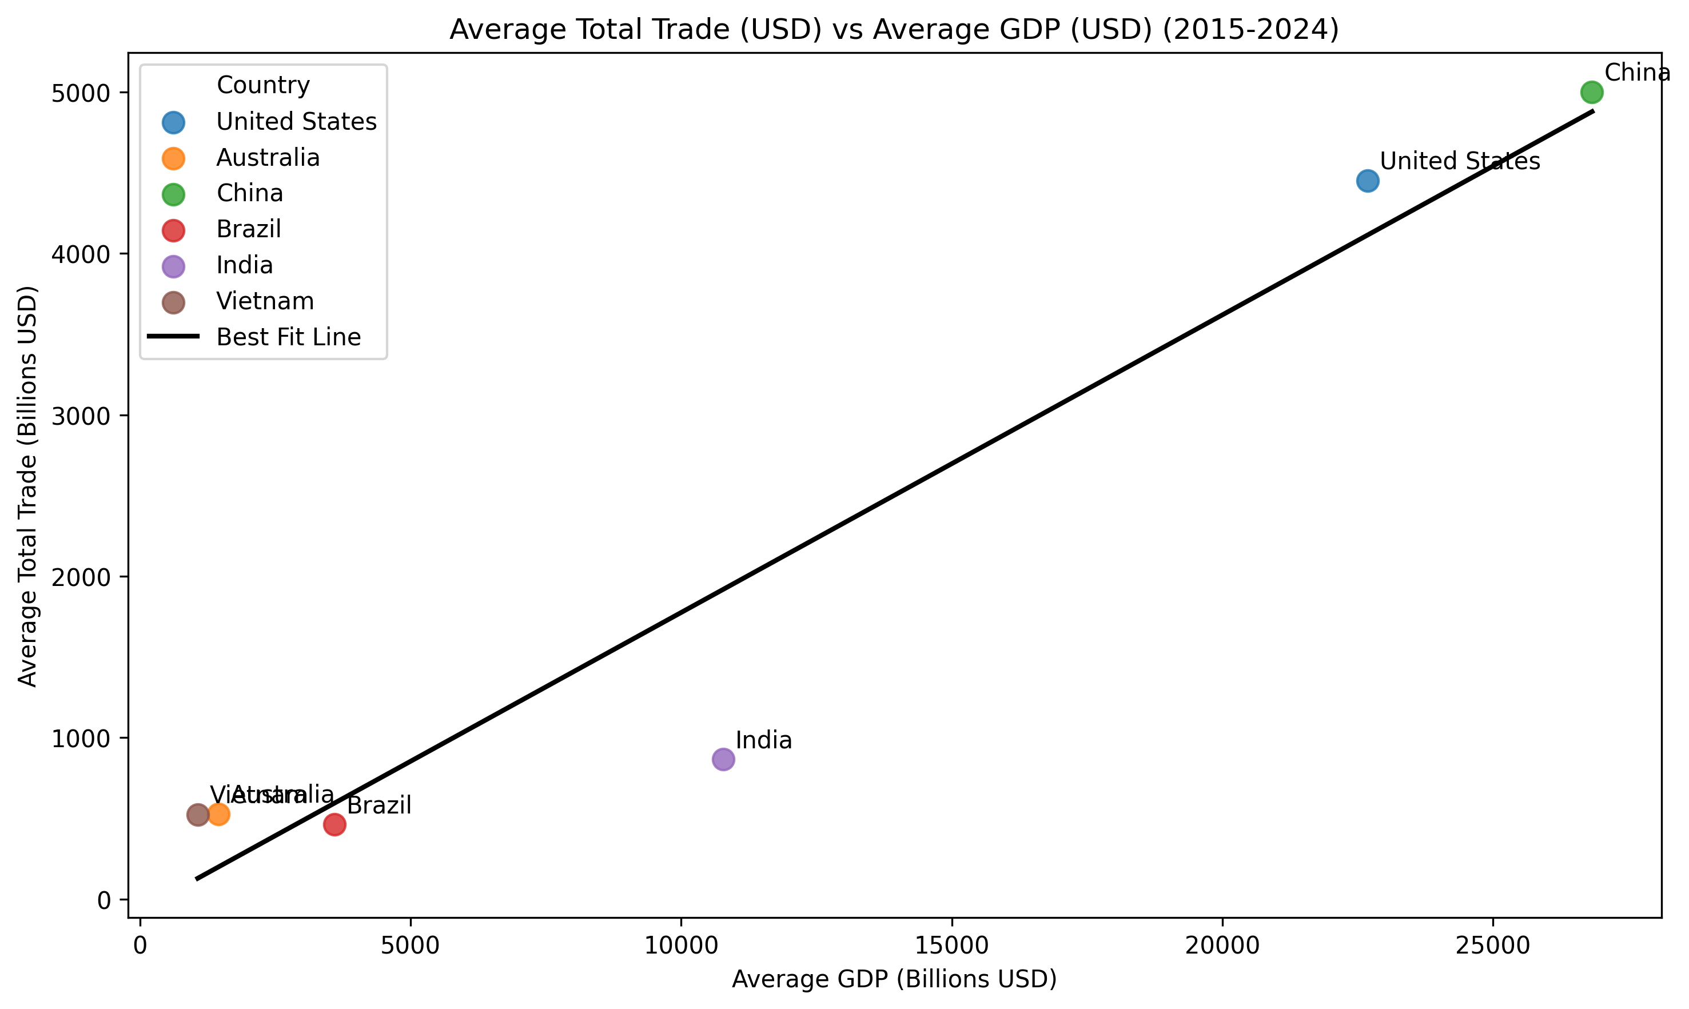

Slide 14
Statistical Analysis – Results
 | Pearson Correlation
Trade vs GDP | 0.96 (very strong positive correlation)
Trade vs GDP per capita | 0.36(weak correlation)
 | Regression (R²)
Trade vs GDP | 92%
Trade vs GDP per Capita | 13%
Statistical tests confirm that GDP is more strongly related to trade activity
Analysis uses all 60 data points(6 countries * 10 years)
The hypothesis testing was implemented using PySpark and its machine learning library.

Slide 15
Insight
  International trade is more strongly influenced by GDP than GDP per capita
  GDP reflects:
  Total economic size
  Production capacity
  Population scale
  Infrastructure and economic resources
  GDP per capita reflects average income levels, however, not the overall economy

Slide 16
Conclusion
GDP has a significantly stronger relationship with trade than GDP per capita
Economic size plays a more important role in determining trade participation than the income per person

Slide 17
Limitations
Study includes only six countries
The analysis covers only ten years of data
Several important factors were not included, such as:
Population size
Industrial structure
Natural resources
Trade policies
Did not analyse how the relation between trade and economic indicators changed over time

Slide 18

Future research
Include larger number of countries and longer time periods
Incorporate additional economic variables
Examine how global economic events influence trade patterns
Analyse long-term changes in international trade relations

Slide 19

Questions

